Slide 1

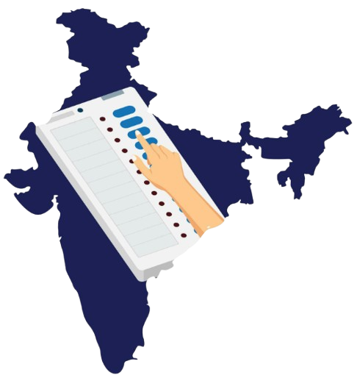
Indian General Election Result 2024
DASHBOARD INSIGHTS
Prepared by
Anushka Srivastava
INDIAN GENERAL ELECTION RESULT 2024

Slide 2

Overview
State Demographics
Political Landscape
Constituency
Details Grid
Problem Statement
The 2024 Indian General Election generated vast, fragmented data across alliances, parties, states, and constituencies, making quick insights difficult.
Traditional news focuses on high-level numbers, leaving gaps in detailed analysis like state performance, constituency results, and vote-type breakdowns.
There is a need for a centralized, interactive, and visually engaging solution that consolidates and simplifies this complex dataset.
The dashboard fulfills this need by transforming static election results into an accessible, dynamic, and multi-level analytical tool.
INDIAN GENERAL ELECTION RESULT 2024

Slide 3
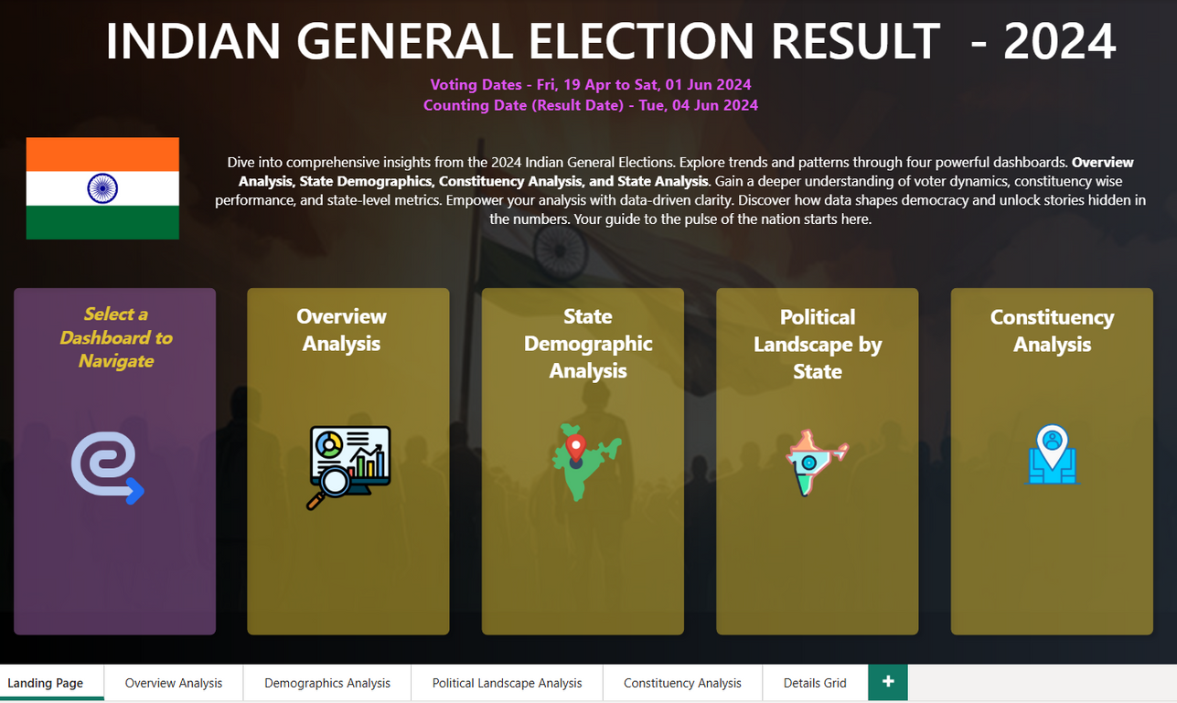
Overview
State Demographics
Political Landscape
Constituency
Details Grid
Landing Page - Engaging and interactive project entry
Central hub providing navigation to all other dashboards.
Features clearly labeled buttons with icons for intuitive user experience.
Minimalist design ensures focus on navigation without visual clutter.
Optimized for different devices, ensuring accessibility across desktops and large screens.
Incorporates hover effects to highlight active selections and guide users visually.
Includes a “Home” button on every dashboard for easy return to the landing page.
INDIAN GENERAL ELECTION RESULT 2024

Slide 4
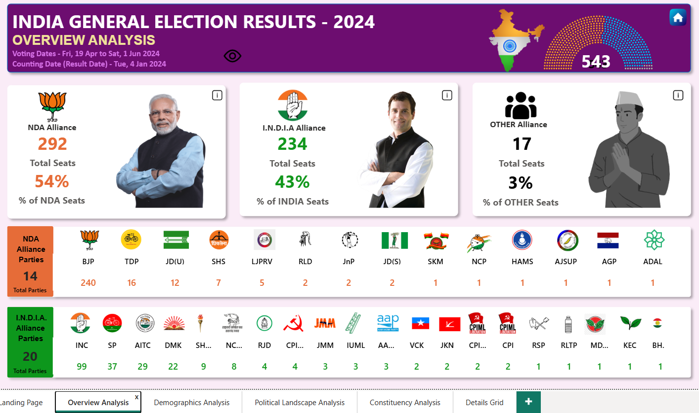
Overview
State Demographics
Political Landscape
Constituency
Details Grid
Overview Analysis - A comprehensive summary of results and trends.
Presents a national-level summary of results for major alliances: NDA, I.N.D.I.A., and Others.
Displays total seats, percentage share, and bookmarked views for detailed seat-level tables.
Highlights comparative strengths and weaknesses of each alliance.
Uses high-impact visuals like color-coded bar charts and party logos to make data intuitive.
Enables users to quickly grasp overall election trends before diving deeper.
INDIAN GENERAL ELECTION RESULT 2024

Slide 5
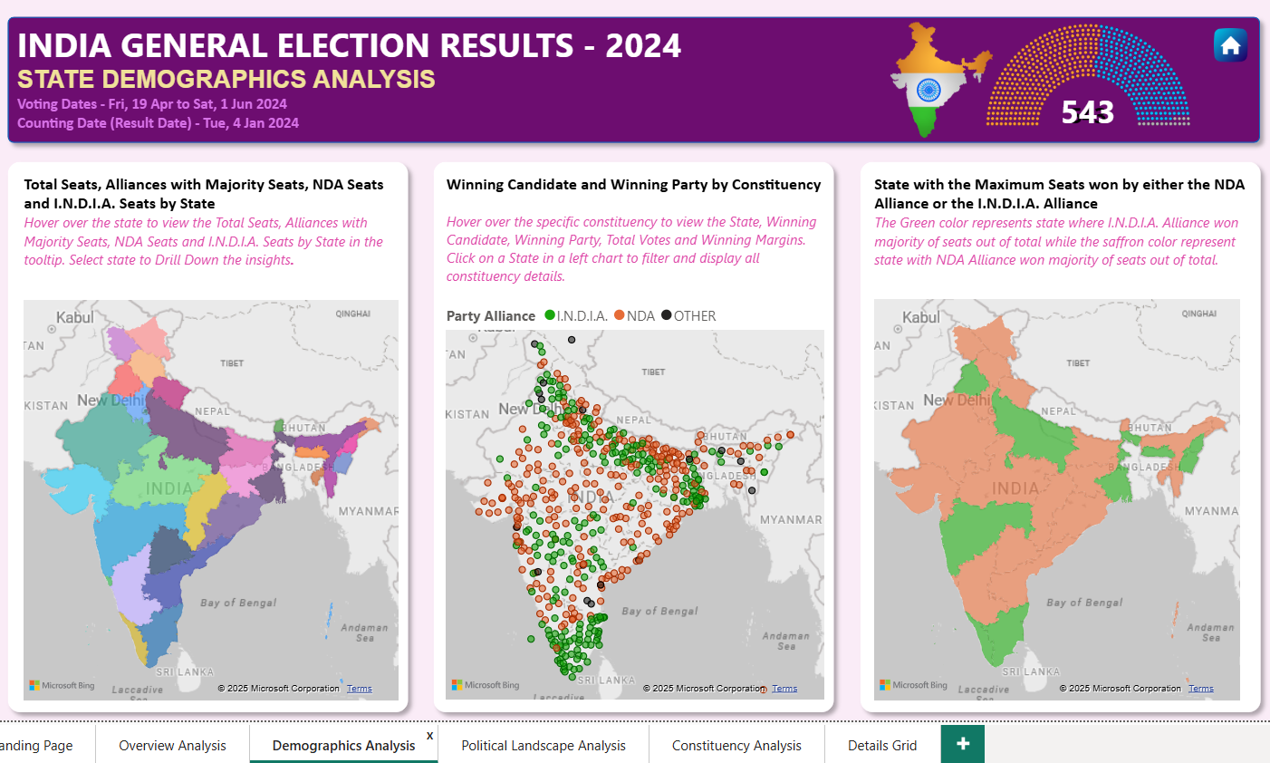
Overview
State Demographics
Political Landscape
Constituency
Details Grid
Demographics Analysis - State-level insights with dynamic metrics
Offers a state-by-state breakdown of seat counts for NDA, I.N.D.I.A., and Others.
Interactive state map visualizes political control geographically.
Bubble maps display constituency-level results with size representing total votes and color coding for alliance affiliation.
Drill-through allows exploration of state-specific detailed tables or deeper context.
Supports analysis of regional political dominance and voter distribution patterns.
INDIAN GENERAL ELECTION RESULT 2024

Slide 6
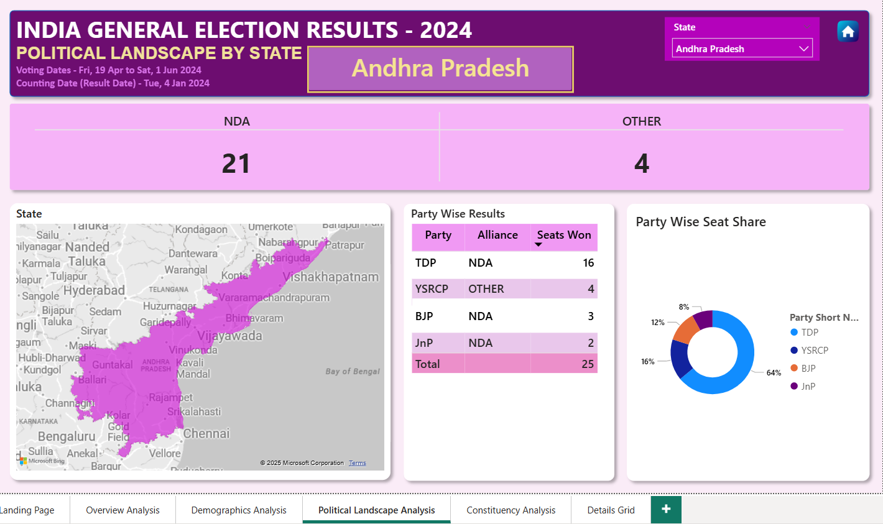
Overview
State Demographics
Political Landscape
Constituency
Details Grid
Political Landscape - State-level insights with dynamic metrics
Allows users to select a specific state and analyze its internal political distribution.
Presents seats won by each alliance and independent parties.
State map overlays show constituency boundaries and party dominance.
Grid view lists winning parties with alliance affiliations for transparency.
Donut chart visualizes seat share percentage for visual comparison of party influence.
INDIAN GENERAL ELECTION RESULT 2024

Slide 7
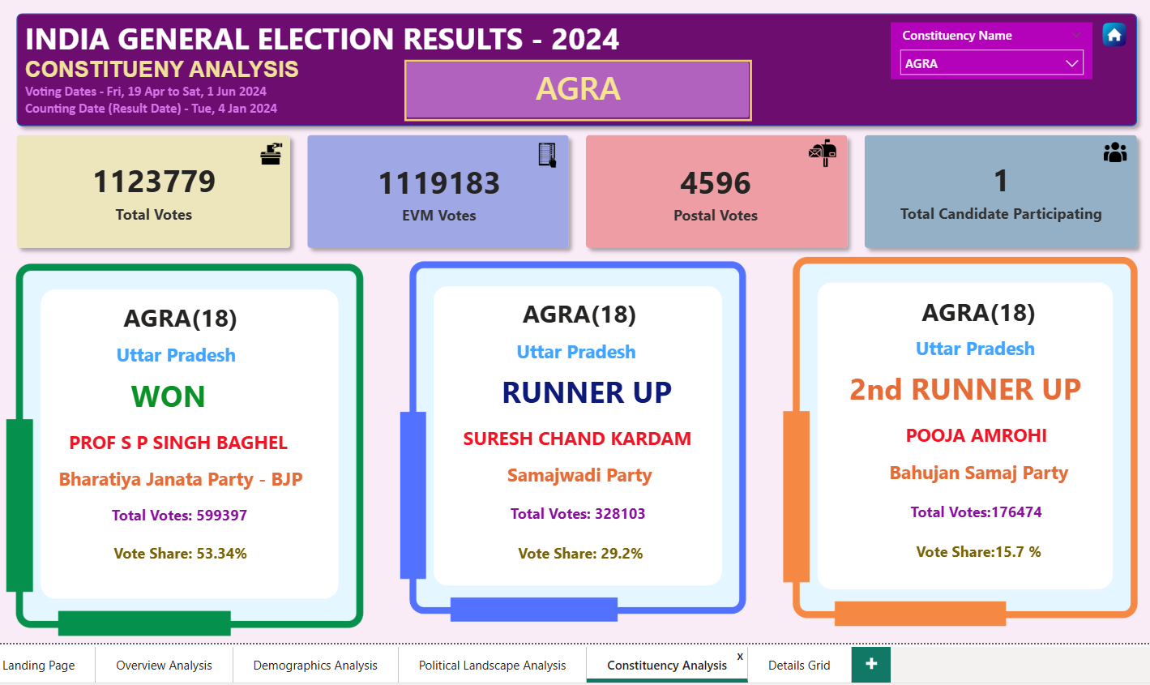
Overview
State Demographics
Political Landscape
Constituency
Details Grid
Constituency Analysis - Detailed constituency-level exploration
Focuses on a single constituency with detailed election metrics.
Displays total votes, EVM votes, postal votes, and candidate count for context.
Lists top three candidates with vote counts and percentages for competitive insight.
Enables evaluation of vote margins and strength of individual candidates.
Useful for identifying close
contests, voter turnou trends,
and local party performance.
INDIAN GENERAL ELECTION RESULT 2024

Slide 8
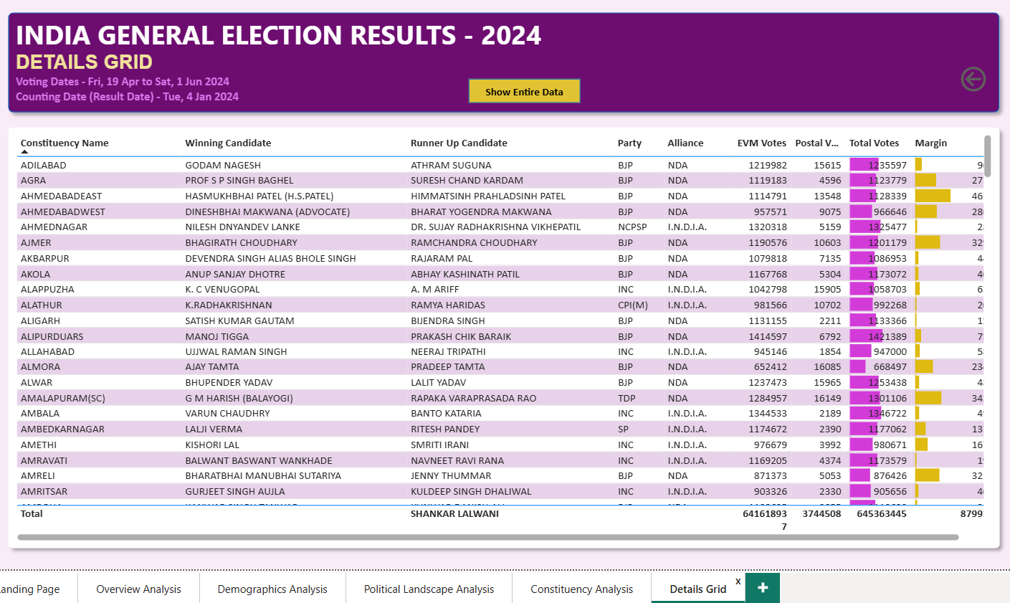
Overview
State Demographics
Political Landscape
Constituency
Details Grid
Details Grid - Grid that used Drill Through to see underlying data
Acts as the master dataset view for all constituencies.
Shows detailed information: constituency name, winning and runner-up candidates, party affiliations, vote types, and margins.
Allows users to export data for external analysis.
“Show All Data” functionality resets filters to display the complete dataset.
Serves as a foundation for custom analyses beyond the visual dashboards.
INDIAN GENERAL ELECTION RESULT 2024

Slide 9
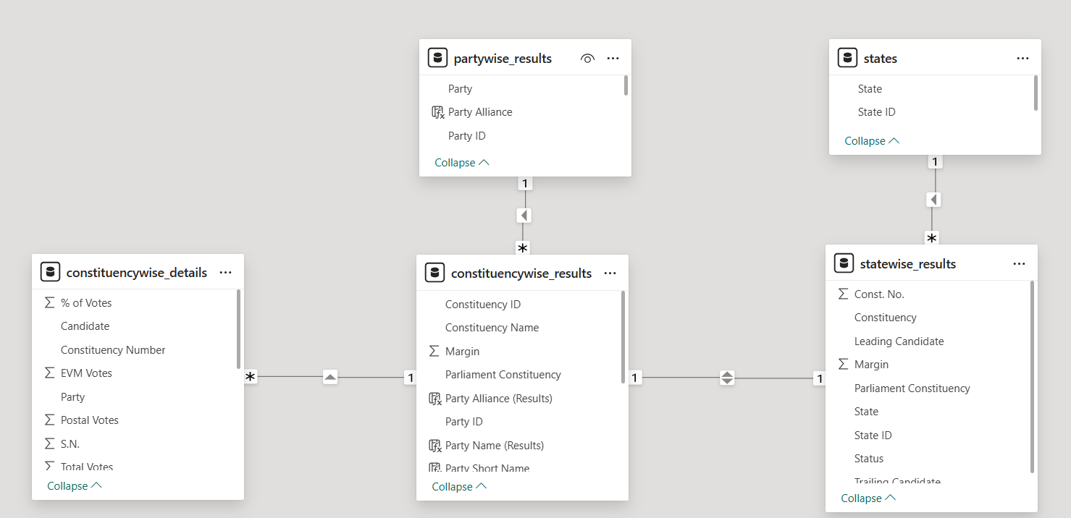
Entity Relationship Diagram
INDIAN GENERAL ELECTION RESULT 2024

